Slide 1
Optimizing Refinery Operations
Abdulrahman Alturki
EBGN 645: Computional Economics
Final Project
December 01, 2025
Notes:
Hello everyone, my name is Abdulrahman and today I will be presenting my final project about optimizing refinery operations

Slide 2
Research Question
  Refined Products such as Gasoline and Middle Distillate are essential for daily life needs including transportation, operating industries, paving roads, and running equipment, other related critical needs to run our day smoothly. This study aims to show how an integrated LP, NLP, and MCP modeling structure can assess refinery performance, optimize product allocation, and measure market output levels under capacity constraints and crude supply availability. The aim of this study is to show how the most optimum refinery in a certain area generates profit and adjust production figures in response to market challenges and across several scenarios to demonstrate how production levels (outcomes) vary across LP, NLP, and MCP structures.
Notes:
Refined products are mainly used for operating industries, transportations, and satisfying humans daily needs. Therefore, this study targets to show how an integrated LP, NLP, and MCP modeling structure can assess refinery performance, optimize product allocation, and measure market output levels under capacity constraints and crude supply availability. The aim of this study is to show how the most optimum refinery in a certain area generates profit and adjust production figures in response to market challenges and across several scenarios to show how production levels (outcomes) vary across LP, NLP, and MCP structures.

Slide 3
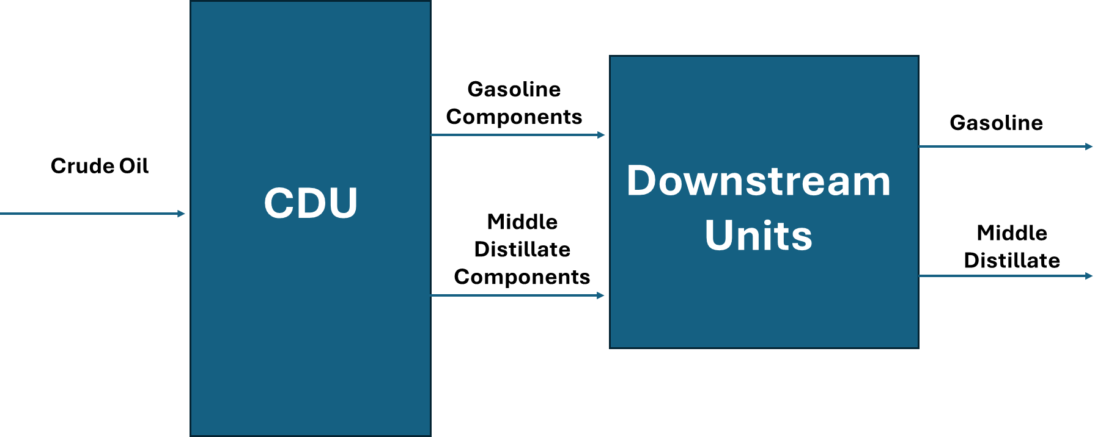
Motivation
Main Highlights about the Project
Energy sector is growing rapidly and representing a great opportunity for profit maximization
Refineries play a critical role as it converts the crude oil to more valuable products called refined products
Refinery operations depend on refined products demand, crude availability and prices, capacity limitations, and environmental regulations
Efficient refinery optimization ensures reliable supply for businesses and householders, which supports economic stability and enhances energy supply securities
Notes:
Starting with a background, energy sector in growing rapidly and it has a high economic value, in which refineries play a critical role in that sector. Basically, the refineries convert the crude oil to refined products (more valued product).
Refinery operations depends on the refined product demand, crude availability and prices, operational and logistical limitations, and environmental regulations.
Efficient refinery optimization ensures reliable supply for businesses and householders, which supports economic stability and enhances energy securities

Slide 4
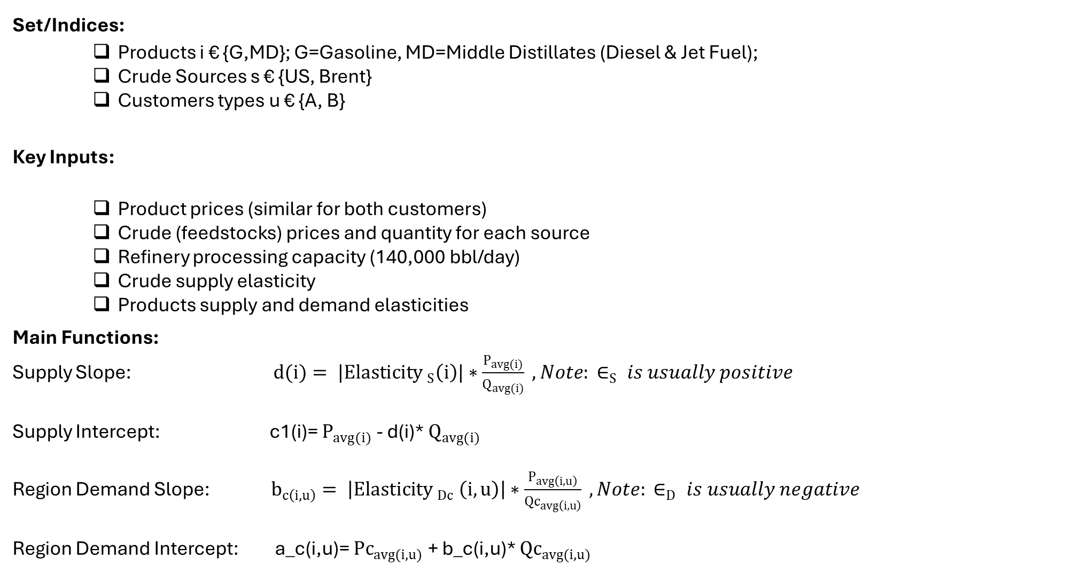
Model Formulation
Set/Indices:
    Products i € {G,MD}; G=Gasoline, MD=Middle Distillates (Diesel & Jet Fuel);
    Crude Sources s € {US, Brent}
    Customers types u € {A, B}
    Key Inputs:
    Product prices (similar for both customers)
    Crude (feedstocks) prices and quantity for each source
    Refinery processing capacity (140,000 bbl/day)
    Crude supply elasticity
    Products supply and demand elasticities
    Main Functions:
Supply Slope: $d(i)= |{Elasticity }_{S}\left(i\right)|∗\frac{P_{avg(i)}}{Q_{avg(i)}} , Note: ∈_{S} is usually positive$
Supply Intercept: c1(i)= $P_{avg(i)}$ - d(i)* $Q_{avg(i)}$
Region Demand Slope: $b_{c\left(i,u\right)}= \left|{Elasticity }_{Dc} \left(i,u\right)\right|∗\frac{P_{avg\left(i,u\right)}}{{Qc}_{avg\left(i,u\right)}} , Note: ∈_{D} is usually negative$
Region Demand Intercept: a_c(i,u)= ${Pc}_{avg(i,u)}$ + b_c(i,u)* ${Qc}_{avg(i,u)}$
Notes:
The model has three different sets or indices, products where we have gasoline and middle distillate. Middle distillate is diesel that is used as fuel to run the equipment and jet fuel that is used for airplane. The second set or group is the crude source, in which we have US crude and Brent Crude. Third set is the customer type, where we have customer A and B.
The key inputs for this model is product prices, crude prices, crude supply elasticity, product demand elasticity, and refinery processing capacity or throughput.
Main functions used in the model is supply slop that depends on supply elasticity, and supply intercept. In addition to region demand slope that depends on product demand elasticity, and region demand intercept.
In the next slides we are going to discuss the main equation utilized for each part of the code.

Slide 5
Model Formulation- Continued
LP
NLP
MCP
Notes:
As we see here, the model is combination of three different part namely LP, NLP, and MCP.

Slide 6

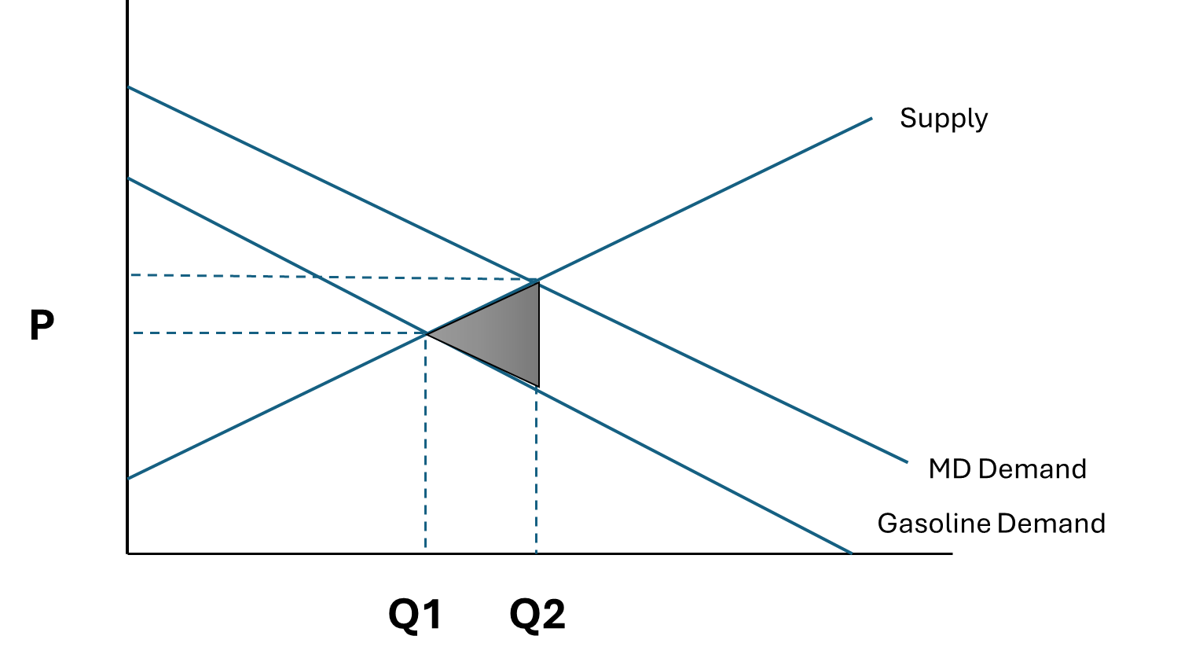
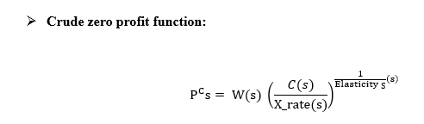
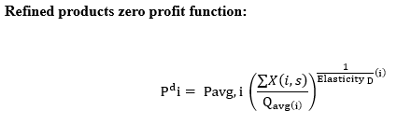
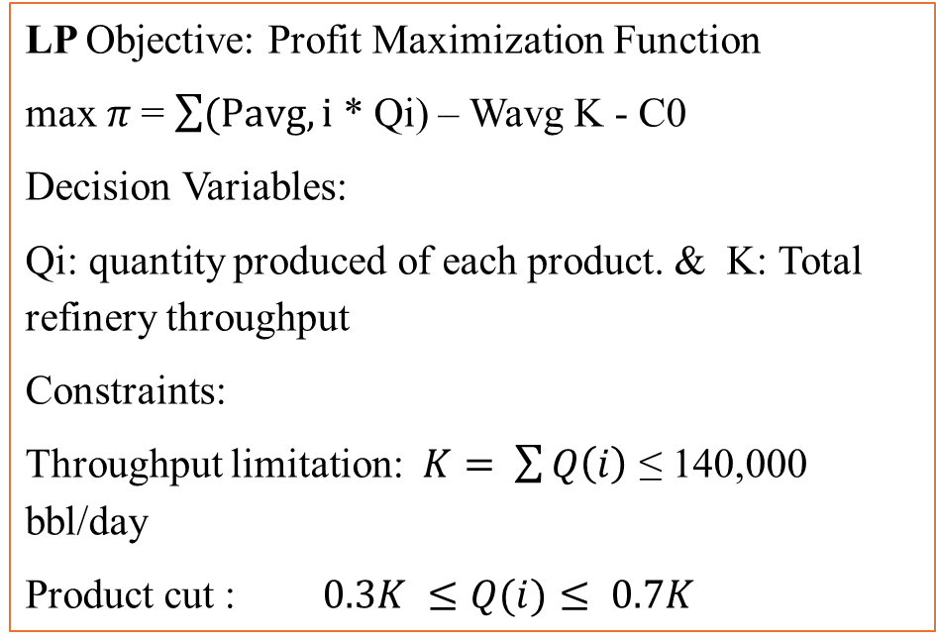
Model Formulation- Continued
LP Objective: Profit Maximization Function
max$π$ = $\sum{(Pavg,i}$ * Qi) – Wavg K - C0
Decision Variables:
Qi: quantity produced of each product. & K: Total refinery throughput
Constraints:
Throughput limitation: $K= \sum{Q\left(i\right)}$ ≤ 140,000 bbl/day
Product cut : $0.3K ≤Q(i)≤ 0.7K$
NLP Objective: Maximize Total Surplus
MCP: Objective: adjust price and quantities unit reach full equilibrium or hit the constraints
Notes:
Looking into the key equations used for each part and starting with the LP, as we see here LP is basically looking for profit maximization under fixed prices. Profit is revenue minus cost, where revenue is calculated based on the summation of products used times their corresponding prices, and cost is calculated based on the fixed cost plus total cost of crude barrels processed. The main constrain here is the refinery capacity limitation and yield cuts boundaries.
Moving to the NLP, basically it looks for welfare maximization or total surplus that depends on customer surplus and producer surplus. As we see here in the graph we have two demand curves and one supply curve, in which MD has higher total surplus due to its higher market value. Generally, producer surplus is calculated based on the area bounded between supply curve and equilibrium price line, while consumer surplus is calculated based on the area bounded between demand curve and equilibrium price line.
As for the MCP part, as more crude is processed in the refinery, its marginal cost increases based on the supply elasticity. For the product side, as more product available in the market, the product price goes down. Generally, in market equilibrium, quantities and prices adjust unitll marginal cost equals marginal revenue.

Slide 7
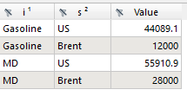

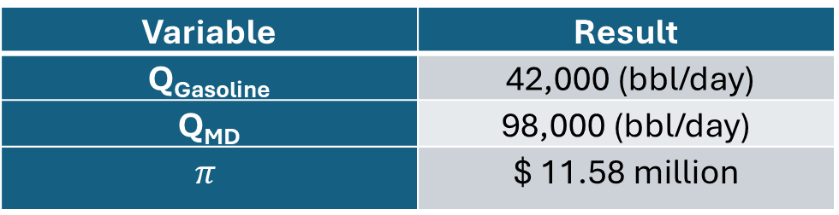
Assumptions , Major Results & Key Conclusion
Major Assumptions:
The refinery produces only two products, namely, gasoline and MD.
Fixed capacity of refinery throughput at 140,000 bbl/day.
Single period model, in which time change effect is not considered here.
Optimization is done by single refinery as it is the most cost-effective refinery in the area
Other supply nodes can meet the rest of the demand, but they are less profitable than this refinery.
LP
MCP
Major Results
Variable | Result
Q_{Gasoline} | 42,000 (bbl/day)
Q_{MD} | 98,000 (bbl/day)
$$π$$ | $ 11.58 million
Variable | Result
Equilibrium Production levels by customers
Equilibrium crude processing rate by type
Qtot | 140,000 bbl/day
NLP
Variable | Result
TS | $ 9.7 million
Notes:
Here are the major assumptions we have for this model.
The refinery produces only two products, namely, gasoline and MD.
Fixed capacity of refinery throughput at 140,000 bbl/day.
Single period model, in which time change effect is not considered here.
Optimization is done by single refinery as it is the most cost-effective refinery in the area
Other supply nodes can meet the rest of the demand, but they are less profitable than this refinery.
Looking into the results, we see here LP generate 42,000 bbl./day of gasoline and 98,000 bbl./day of MD with total profit of 11.6 million dollar daily.
As NLP looks for total welfare maximization, we see it has a value of $ 9.7 million
Last but not least, we have here MCP outputs, which highlights the full equilibrium in which the crude it keep processed till MR=MC or we hit the limitations. Compared to the LP part, we notice MCP part produces more gasoline and less MD due to price adjustment under equilibrium. Which means, under equilibrium, gasoline shows more valuable price as production increases, while MD loses its value quicker. As a result of that, the model shifts production toward gasoline to maximize the economic benefit.

Slide 8
Vision for Future Advancement/Expansion:
  Centralized Optimization Platform: Expand the model into a centralized system that optimizes the entire refined products supply chain and find the most efficient way to meet the whole demand (by coordinating refineries production levels, pipeline, and shipping routes.
  Synchronizing Operations and Logistics: Integrating the operational and logistical aspects into this unified system, considering maintenance activities schedule, storage capacity, production rates, and demand commitment
  Smart Advisory Tool : Using advancing monitoring tools to improve planning accuracy, reduce downtime, avoid major maintenance activities overlap, and maintain on-spec products
  Long-Term Reliability: Introduce performance KPIs that measure supply reliability and customer satisfaction, aiming for continuous improvement
Notes:
Since we see value of this model and going with expansion will help and generate more profitability. With unlimited time, funding, energy, and personnel, the project would upgrade into a national centralized optimization tool that optimizes the entire refined products supply chain.
Integrating the operational and logistical aspects into this unified system, considering maintenance activities schedule, storage capacity, production rates, and demand commitment to produce efficient supply plan.
Applying smart advisory tool that monitors the operations very closely and make quick and efficient decisions quickly.
Introducing KPIs performance that measure supply reliability and customer satisfactions, aiming for continuous improvement

Slide 9
Thank you
Notes:
With this I will conclude my presentation, that you for your time and attention.

